Slide 1
Who to Call on Call (and other helpful tips)
CO-CHIEFS:
David Lam
Amy Cheney

Slide 2
Overview
Who to call on call
Card A/consults
Scheduling questions
Procedure call
Pearls

Slide 3
Cardiology A
1 card A fellow per block
M, W, F and some weekends, 8a-8p
T/Th – UW echo 1st year covers 5p-8p
Weekdays 5p-8p + Weekends 8a-8p =
card A + general consults

Slide 4
Cardiology A
Responsibilities:
Team: attending, 1 fellow, residents, 1 intern
Supervise team
Supervise admissions
Supervise hand offs
See, staff consults 5p-8p*, communicate to team
Learn beyond patient care
*in the beginning (and arguably throughout) discuss with an attending (card A attending on call)
If you see a consult after hours, COMMUNICATE!
- email/text fellow on days
- add to the General Consults Orca list
Notes:
Institutional memory: previously interns

Slide 5
Cardiology C
Gone for the month of July
Overflow service for straightforward general cardiology admissions (or sometimes not) – NSTEMI, new AF with RVR, etc

Slide 6
Wait? Am I on call?
Consult UW med hub
Call the operator
Call / text / email Amy (360-220-5404), aec1
Notes:
Seen at UWMC, TTE repeated → bicuspid valve, AI, ascending aortic aneurysm
Get from syngo

Slide 7
Changing call
Sick, emergency, etc
Don’t be a martyr!
Call one of us (Cheney, Lam, Freeman)
Fill out the google form
If <1-2 days, contact operators

Slide 8
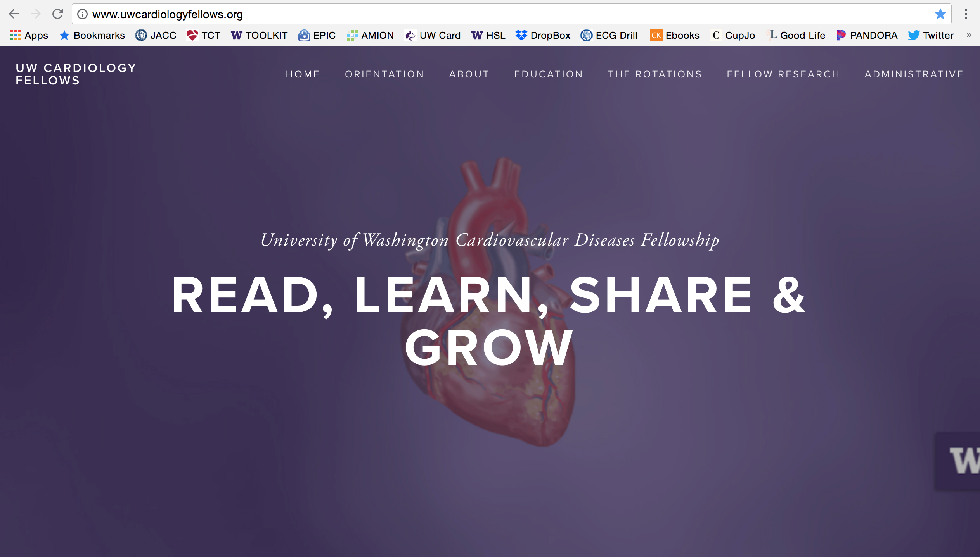
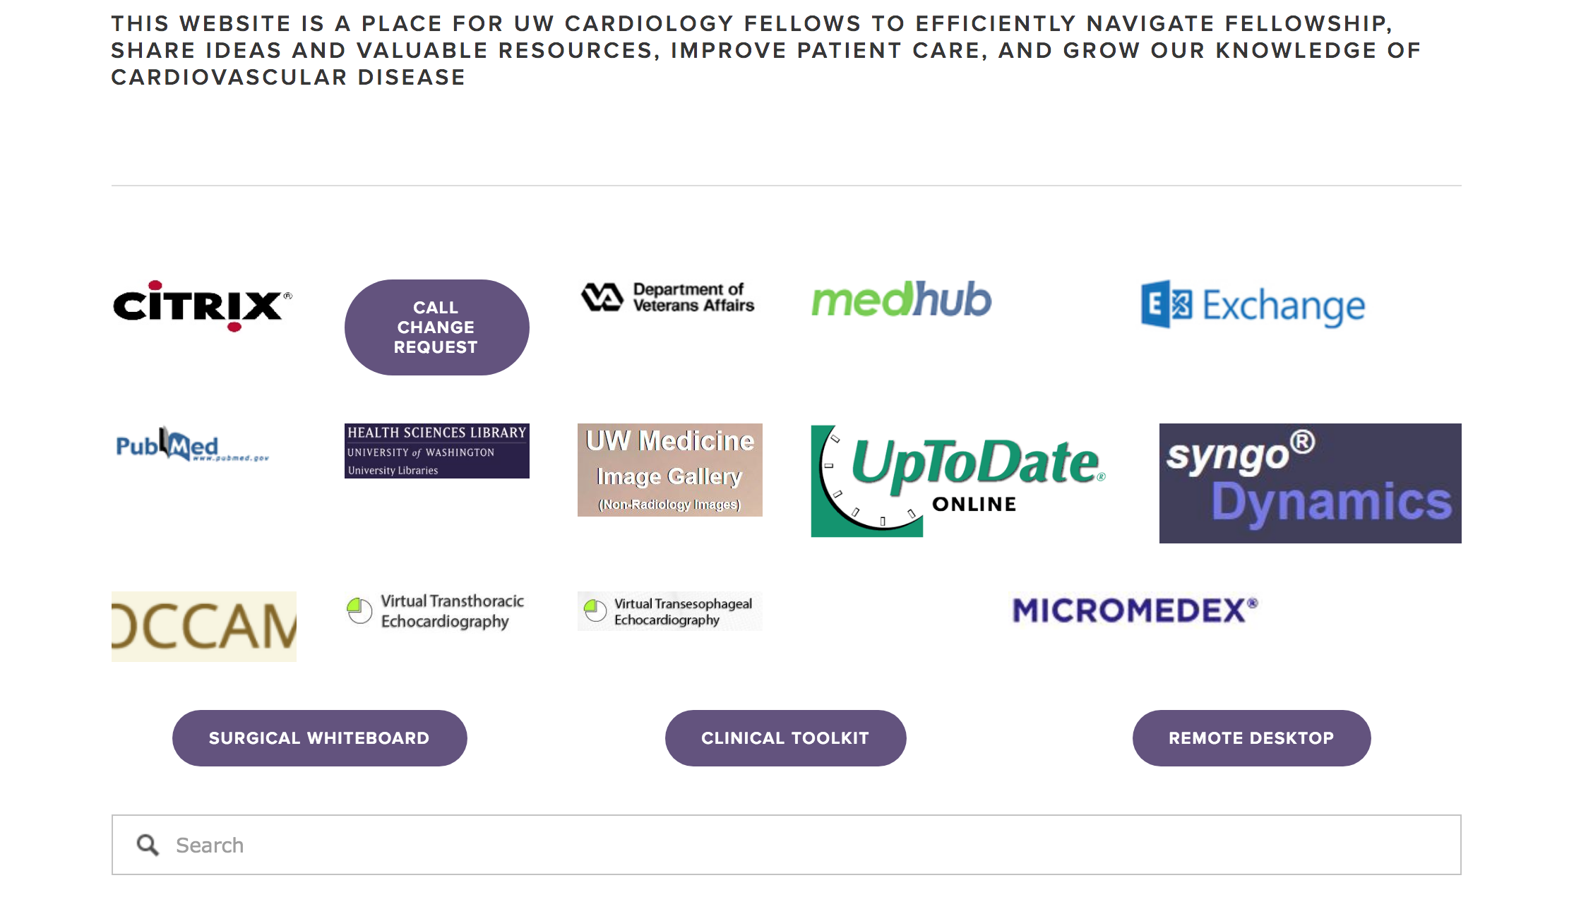
Updates will be complete soon

Slide 9
Procedure Call
Not until after Thanksgiving
Responsibilities:
Echo at UW/HMC
STEMI*/urgent cath UW/HMC
Consults at UWMC (8p-8a)
Take/pass an open book echo test
Have had at least 1 month of echo/cath
Notes:
Try to get video
5.5 cm aorta

Slide 10
Procedural call tips:
Echo: required to go in for each echo; if simultaneous at UW/HMC, triage
You do NOT read all the echoes → card A/B/CCU
STEMI/urgent cath: not required, but recommended. More than just the STEMI.
If going to STEMI, once the page comes, just start driving
For UWMC consults: see, staff: card A attending, communicate to team, note
If you see a consult after hours, COMMUNICATE!
- email/text fellow on day
- add to the list
Notes:
Mildly dilated LV, with LVEF = 36% (on dobutamine)
RV is relatively small with preserved function.
Severe posteriorly directed

Slide 11
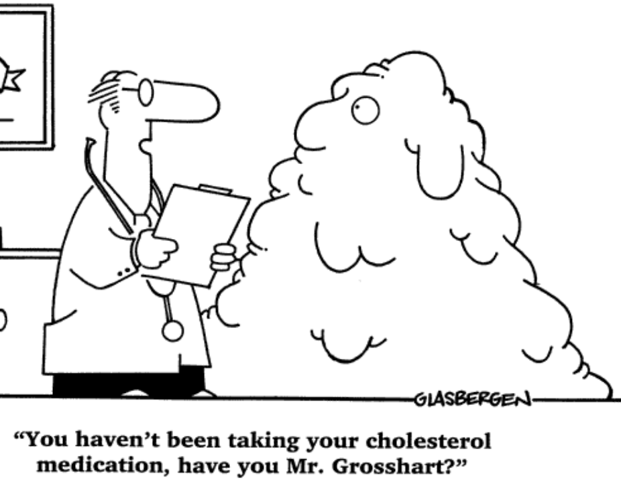
Resources
There are a lot of cardiology fellows/faculty in the hospital!
Days: CCU, card B (HF/transplant), EP, echo II fellows; card A attending
Nights: CCU nocturnist**, Card A/B/C/D nocturnist
24/7: Card A, Cath (IC fellow, general fellow and attending)

Slide 12
Echo or cath after hours?
Page procedure fellow
All funnels through this person

Slide 13
Wednesday Conference
RR 134 (behind cafeteria), 7:30-8:30 am
Audience: cardiology and CT surgery faculty, anesthesia, sonographers, residents, students
Goal: present an interesting case and have tangible learning objectives and cite evidence
Bread and butter is ok – conference is for your co-fellows as well
Golden Rule(s):
Don’t call on your colleagues without warning
Faculty mentor(s)
Experts to speak up (echo, cath, MRI etc)

Slide 14
Echo or cath after hours?
Page procedure fellow
All funnels through this person

Slide 15
Pearls
Chiefs are always a resource
Amy 360.220.5404, aec1
David 267.902.5981, dlam2
Get to as many educational conferences as you can; HMC/VA limits
Try to watch corresponding Mayo Board review before Friday didactics
Once you start procedure call:
You’re never alone (sonographer, cath fellow, attending, Year 2-3 general fellows)
More on this in November!

Slide 16
Questions?
http://www.uwcardiologyfellows.org/
Amy: aec1@uw.edu, 360.220.5404
David: dlam2@uw.edu, 267.902.5981

